Slide 1


IOT SOLUTIONS
DR MOHD HANIF MOHD RAMLI
ABDUL MUQTADIR BIN AB WAHID
MOHD FAZREEL BIN DAUD

Slide 2
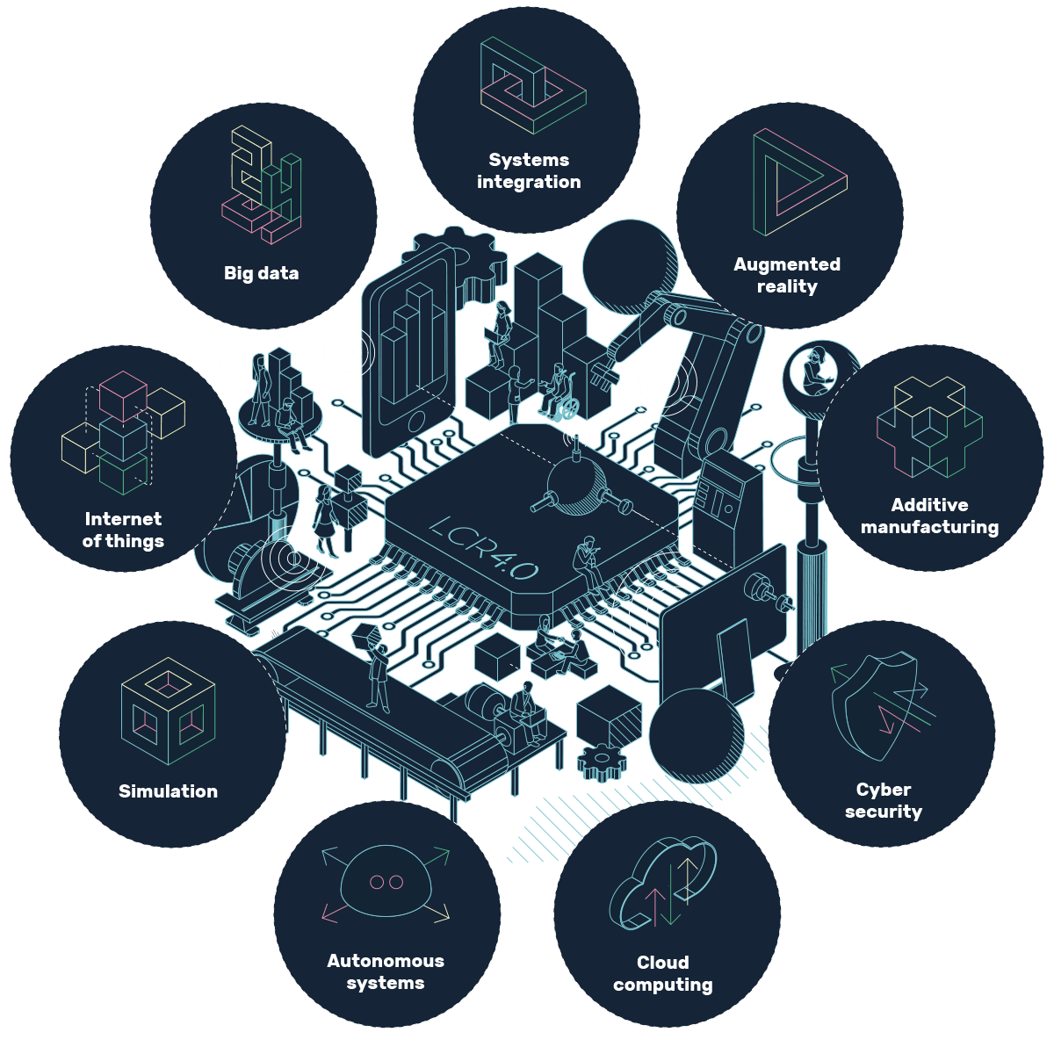
4th INDUSTRIAL REVOLUTION
Our Main Focuses
Big Data
IoTs
Autonomous Systems

Slide 3


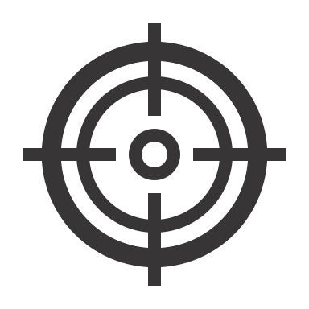
IOTS: CONCEPT
Architecture: an ecosystem of objects equipped with sensors that generate data and interconnected via the internet.
Applications: wide range; from Industrial plants, track and classify information to reduce human interventions.
Goal: Monitor, collect, exchange and analyze information efficiently. It aims on connecting physical devices over a network so that they can communicate with each other and take decisions intelligently.

Slide 4

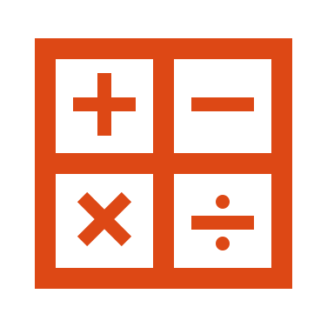


IOTS: BUILDING BLOCKS
Identification and Sensing: Data acquisition
Aggregator (computations): Algorithms, arithmetic.
Communication Channels: TCP, UDP, Web socket, MQTT, & etc.
Services and Semantics (logic): Monitoring, Controls, Predictions.

Slide 5
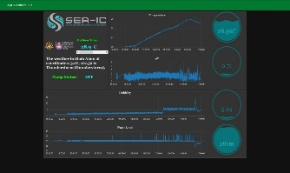
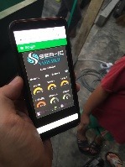
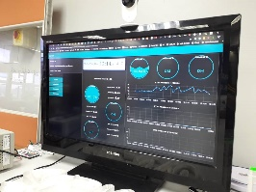

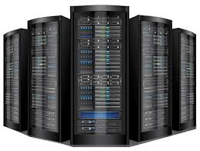
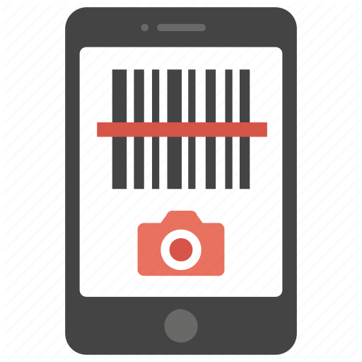
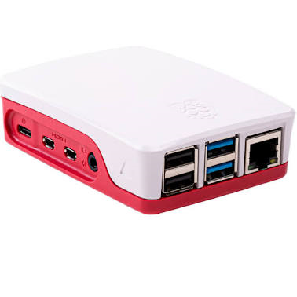
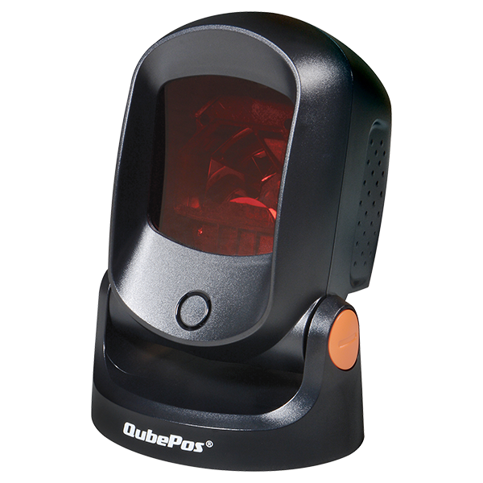
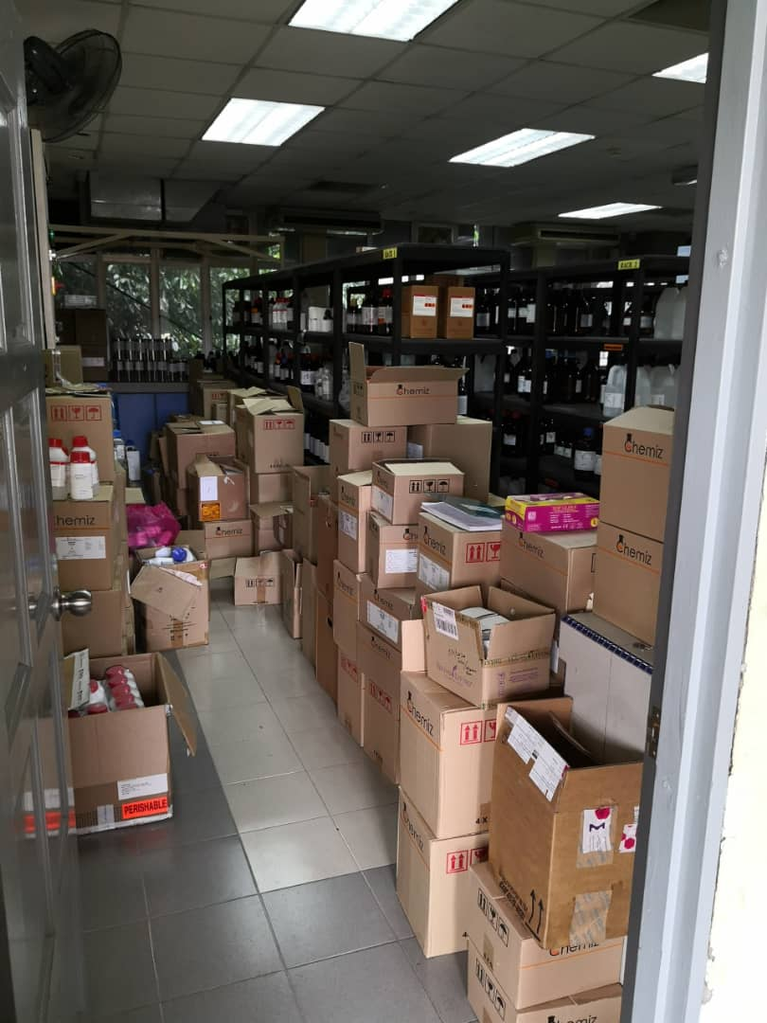
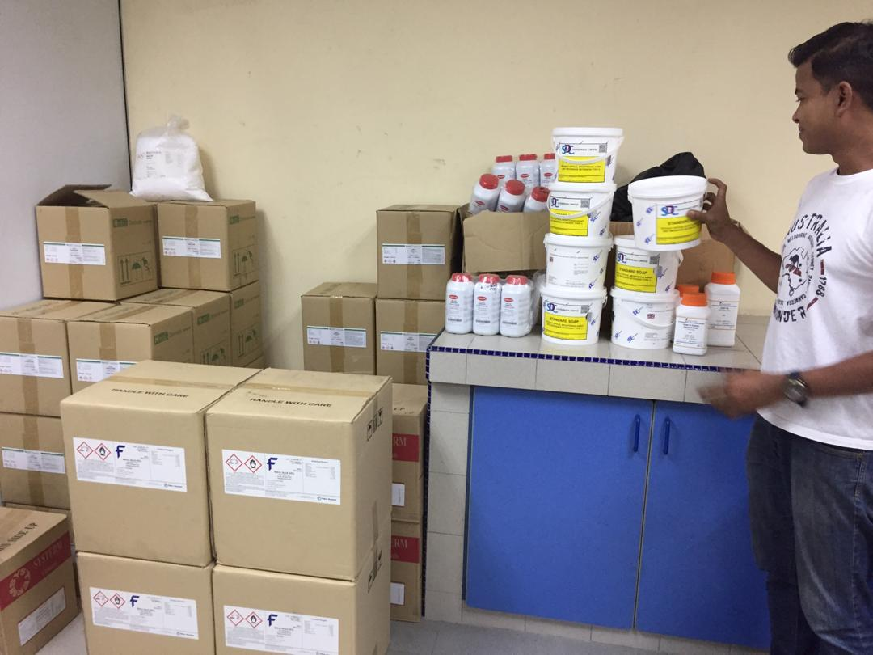
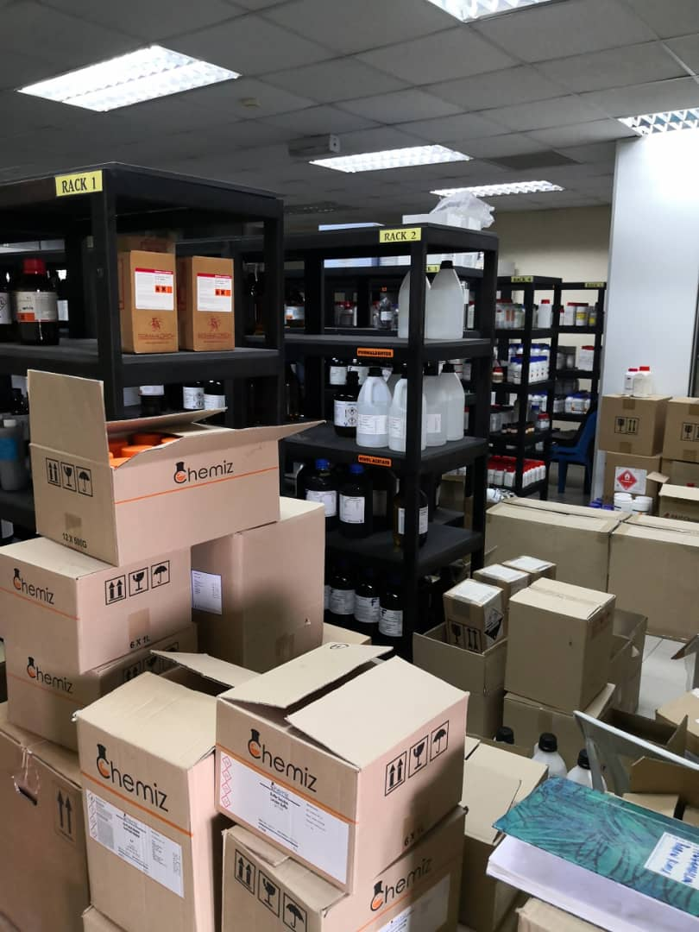
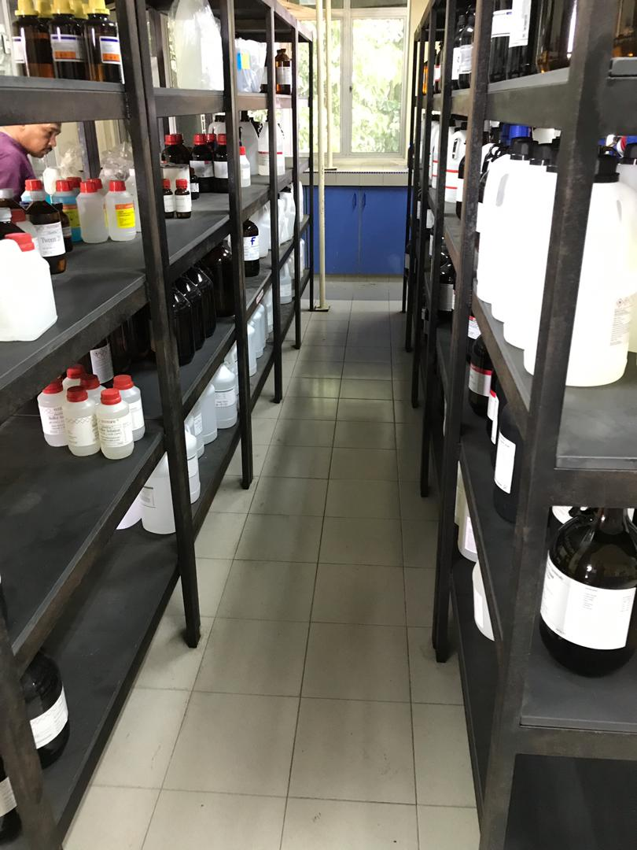
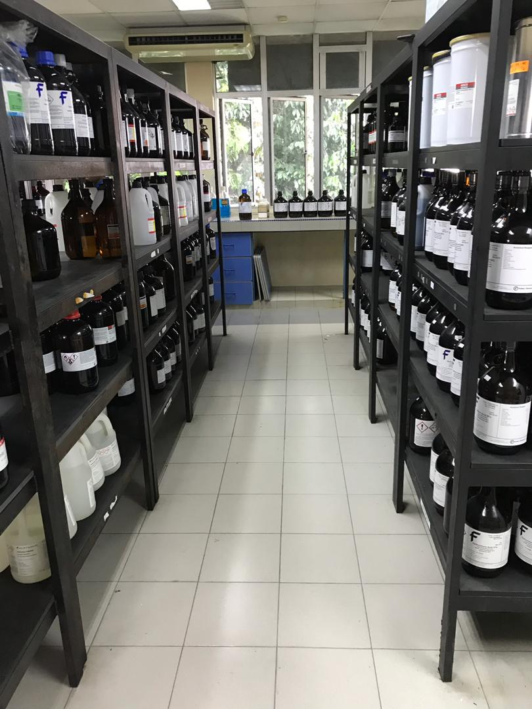
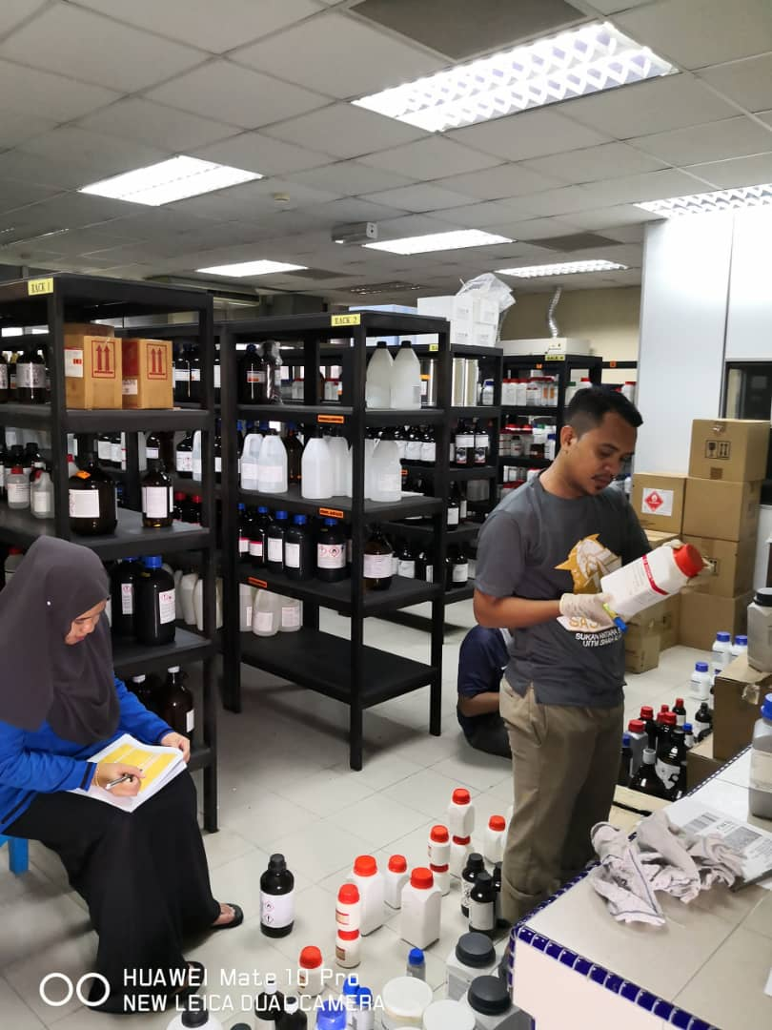
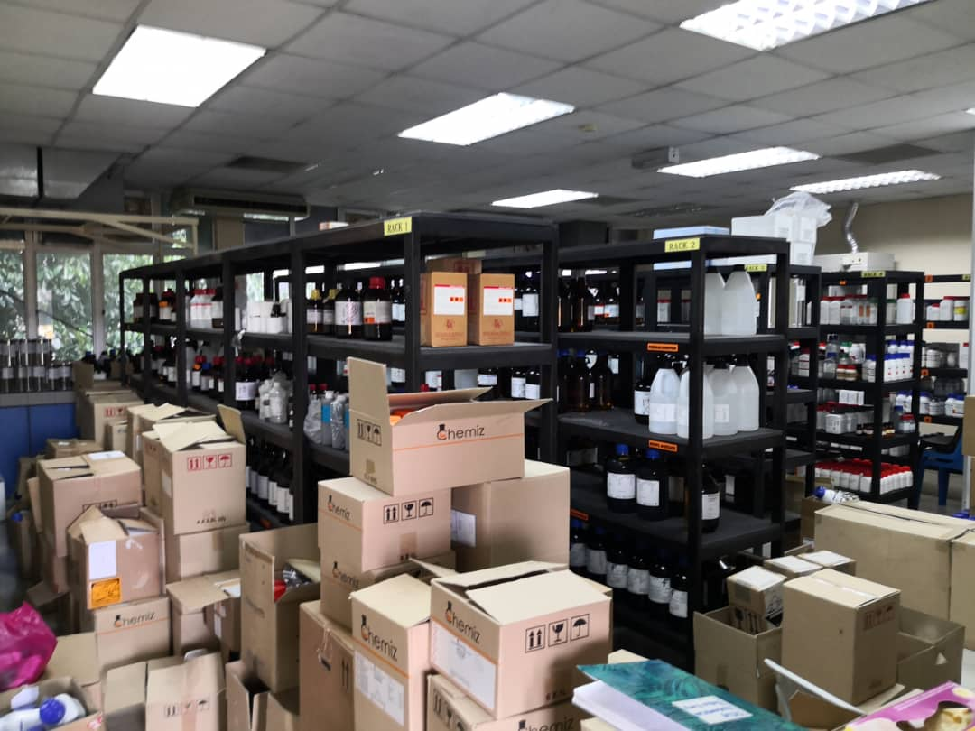

USER LAYER
DEAN/DEP. DEAN/SCIENCE OFFICER
CLOUD LAYER
** Chemical Record (Cloud) **
** Chemical Data Shortage Warning (Control) **
** Chemical Data Prediction (A.I) **
** Chemical Data - Storage (Out) **
** Chemical Data - T&L Lab (In) **
** Chemical Data - Research Lab (In) **
IOT LAYER
PROCESS LAYER
CHEMICAL DATA INPUT VIA QR CODE / MANUAL
CHEMICAL DATA INPUT VIA QR CODE / MANUAL
CHEMICAL DATA INPUT VIA QR CODE / MANUAL
TEACHING & LEARNING LAB (64 LAB)
CHEMICAL STORAGE ROOM (2)
RESEARCH LAB (41)

Slide 6
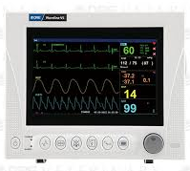



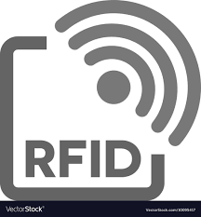
USER LAYER
MANAGEMENT
** ID NO, CYCLE TIME & FPY **
** WORKING HOUR & ATTENDANCE **
** IN & OUT DURATION / TIME **
** OPERATION TIME **
** ANY REQUIRED DATA –
DEPENDING ON
PROVIDED SENSING DATA **
CLOUD LAYER
IOT LAYER
PROCESS LAYER
RFID CONFIG.
KANBAN
(1)
FINAL ASSY
(2)
MLGD
(3)
MECHANICAL INSTALLATION
(4)
COUNTERSINKING
(5)
BOEING
(6)
EDGE SEAL
ROOM
BONDING
ROOM
PAINTSHOP

Slide 7
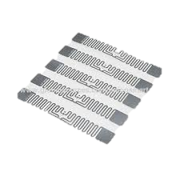
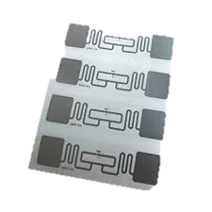
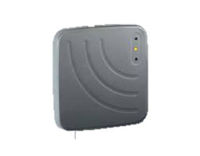
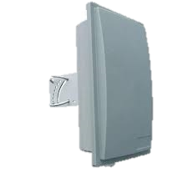
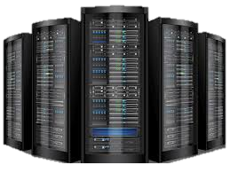
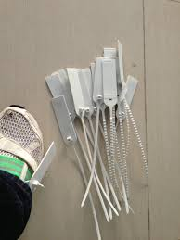
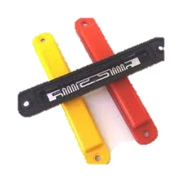
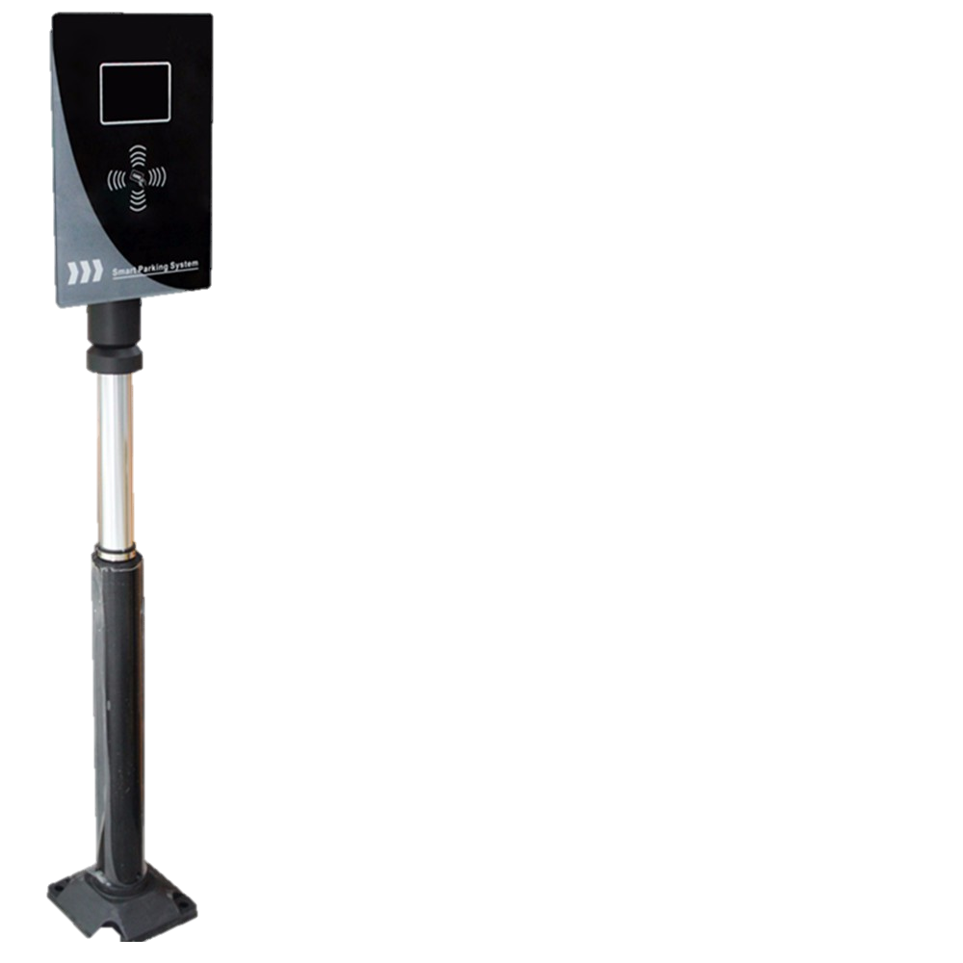
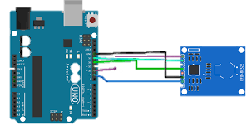
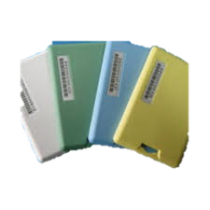
RFID CONFIGURATION
RFID TAG
RFID READER
DATA SERVER
* DEPENDING ON DATA SIZE*
* DEPENDING ON TYPE OF TAG
* DEPENDING ON DETECTION RANGE /DISTANCE

Slide 8
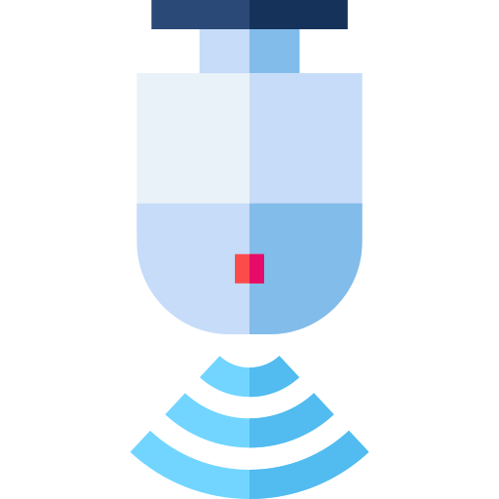


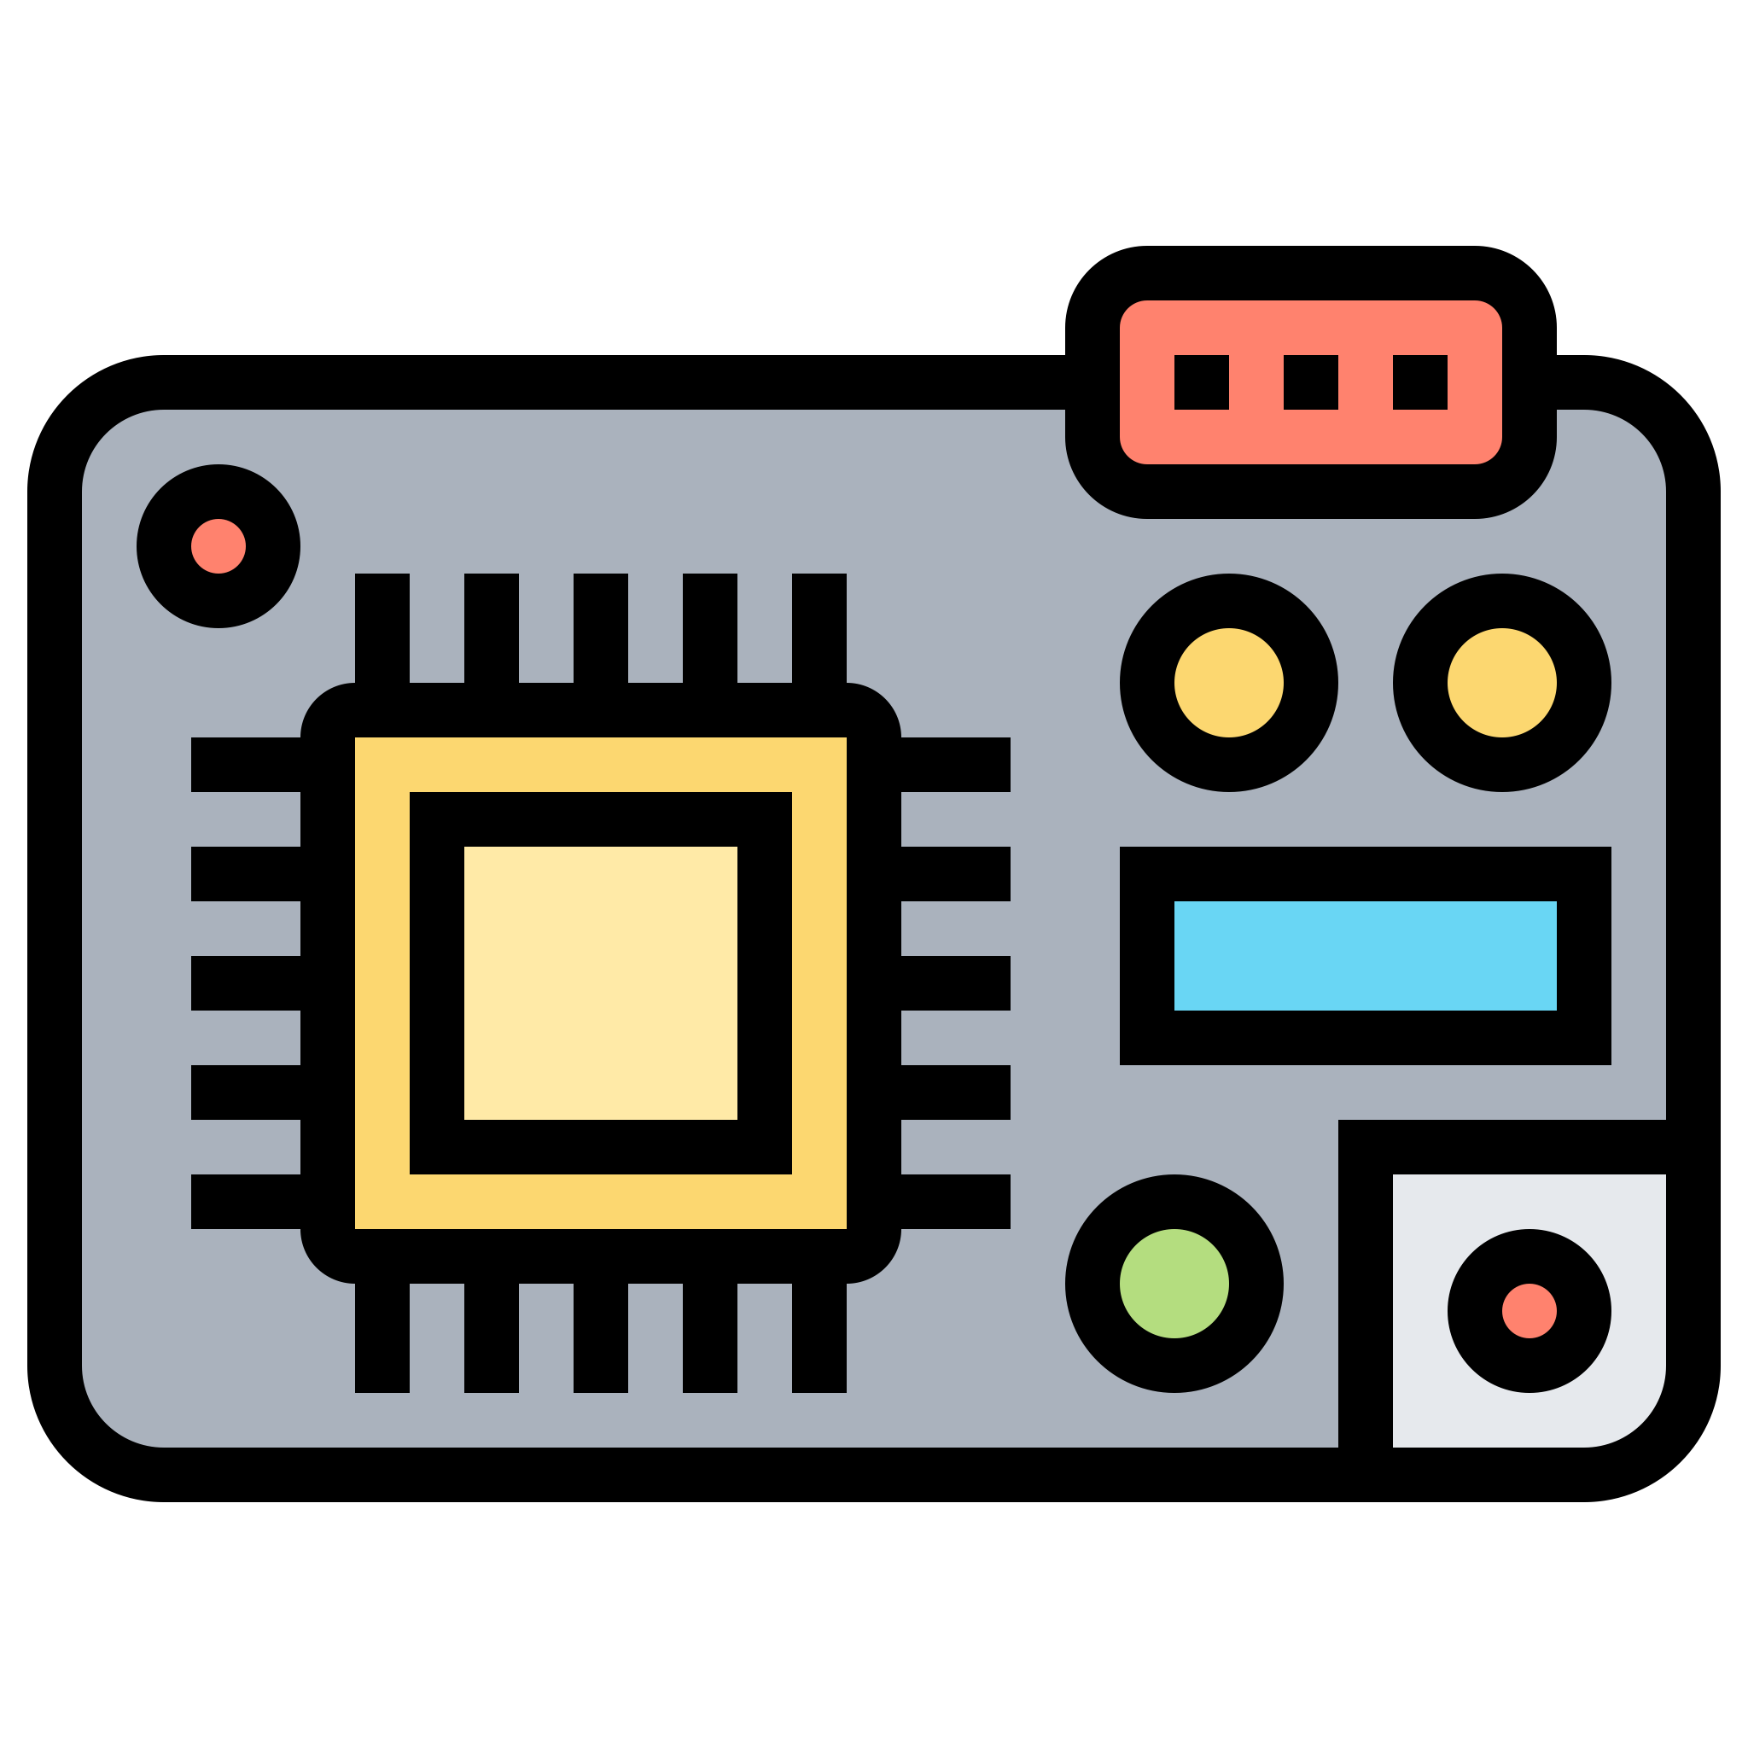


ACQUISITION
DATA
Get parameter measurements from dedicated sensors
TECHS/TOOLS
DATA
Life-Cycle

Slide 9
AGENDA
01
02
03
04
05
06
Hardware
Software
Real life Use Case
Appendix
Q & A
Additional Knwoledge

Slide 10
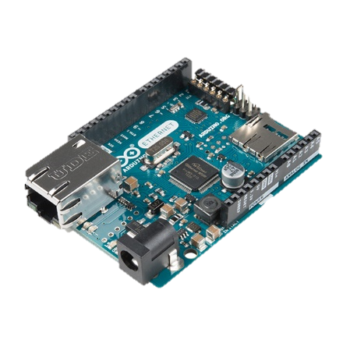
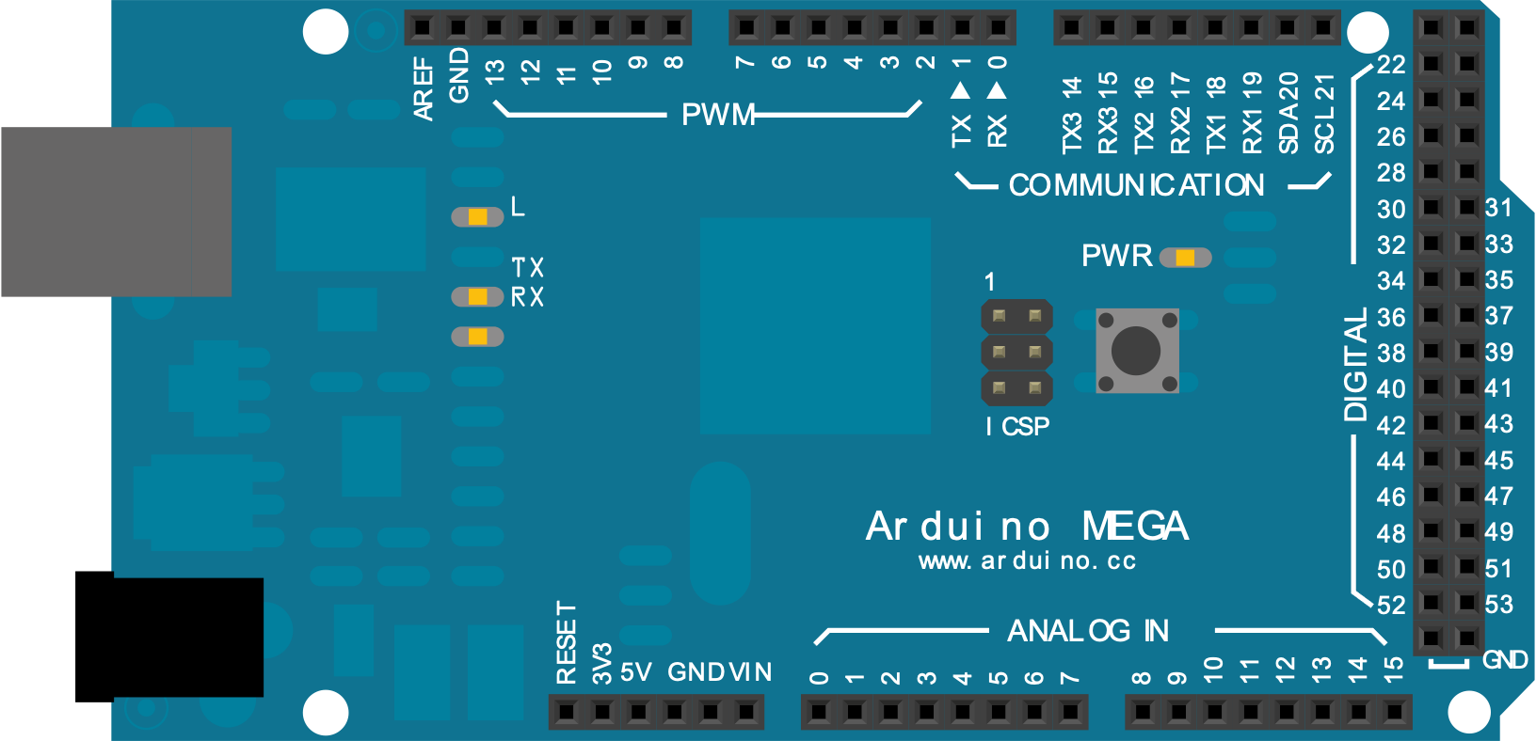
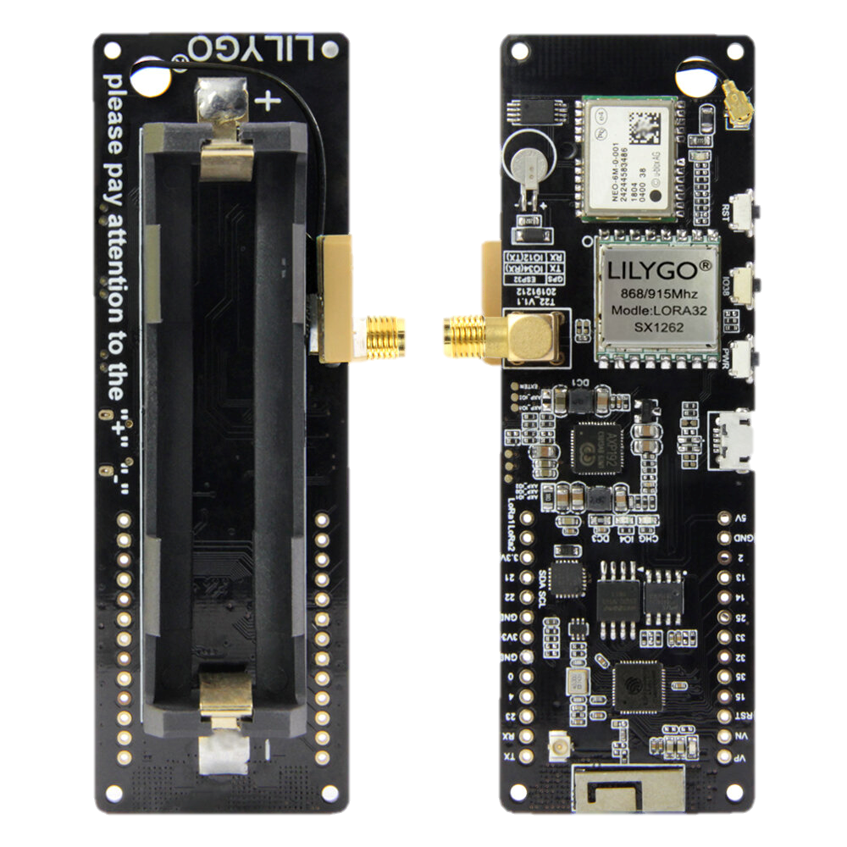
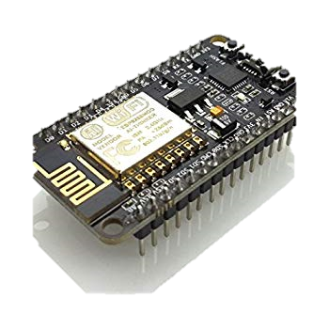
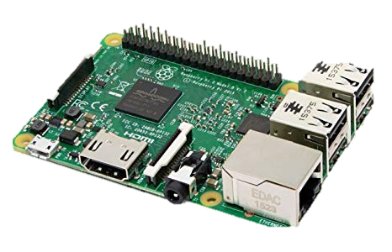
Types of Microcontrollers
Arduino UNO
Arduino MEGA
TTGO LORA
Raspberry PI
ESP8266

Slide 11
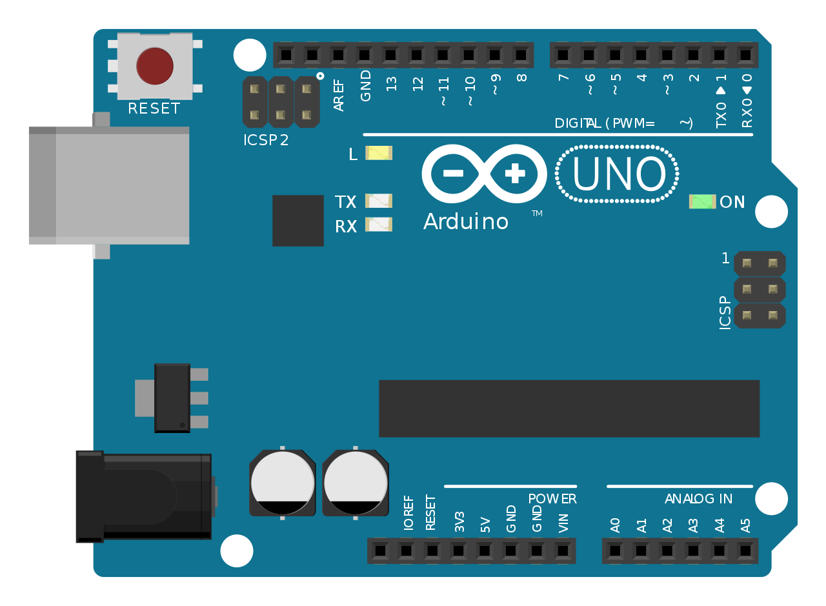
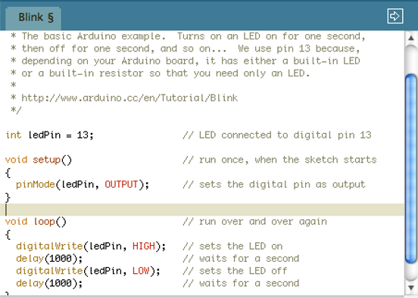
WHAT IS ARDUINO?
Interaction Design Institute Ivrea (IDII) in Ivrea, Italy, 2003
Goal: to create simple, low-cost tools for creating digital projects by non-engineers.
PROPERTY OF SEAIC :: M. H. M. Ramli

Slide 12
Type of Sensors
Camera Sensor
Laser Sensor
Motion Sensor
Current Sensor
Sound Sensor
Touch Sensor
Temperature/Humidity Sensor
GPS Sensor
Infared/Light Sensor
Line Tracking Sensor
Ultrasonic Sensor
Gas Sensor
Color Sensor
Liquid Sensor
Biometric Sensor
Proximity Sensor
Type of Sensors

Slide 13
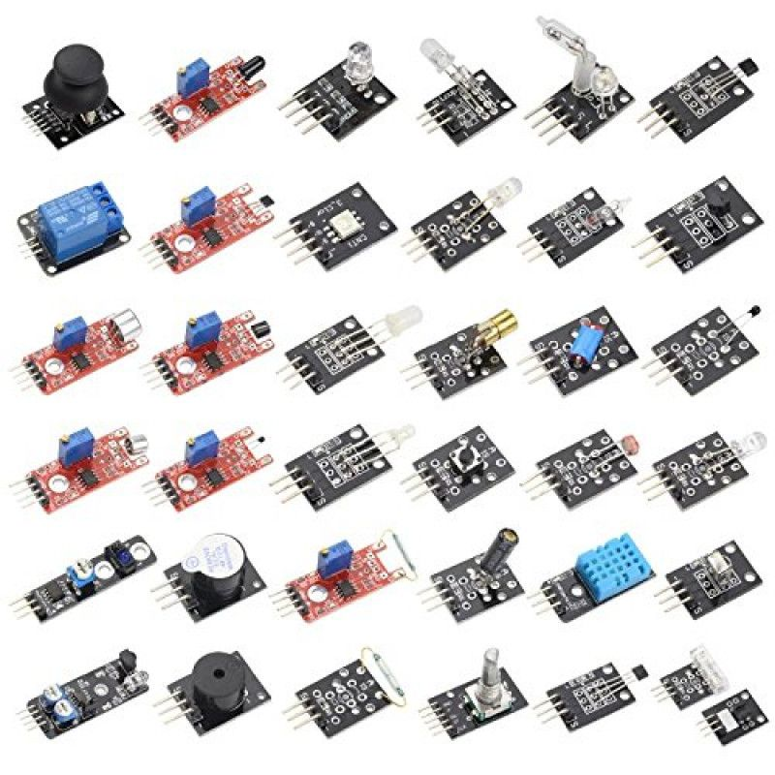
Choosing Your Right Sensors
Reference : https://my.cytron.io/c-sensor

Slide 14
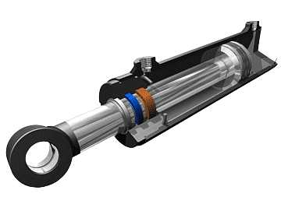
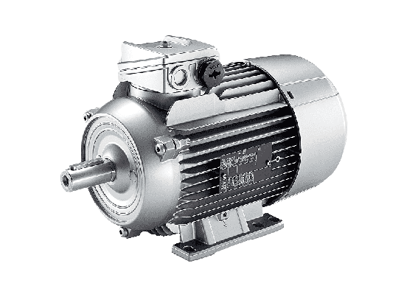
Types of ACTUATORS
Electric Actuators:
Linear Actuators: Create straight-line motion. Used in automation, robotics, & medical equipment.
Rotary Actuators: Generate rotational motion around an axis. Used in valve control, conveyors, and more.
Pneumatic Actuators:
Pneumatic Cylinders: Use compressed air for linear motion. Common in industrial automation.
Pneumatic Rotary Actuators: Produce rotational motion with compressed air.
Hydraulic Actuators:
Hydraulic Cylinders: Utilize pressurized fluid for linear motion. High force for machinery.
Hydraulic Rotary Actuators: Create rotary motion with hydraulic pressure.
Piezoelectric Actuators: Generate voltage from stress for precise movement, e.g., positioning.
Solenoid Actuators: Controlled by electromagnets for linear/rotary motion. Common in locks, valves, autos.

Slide 15
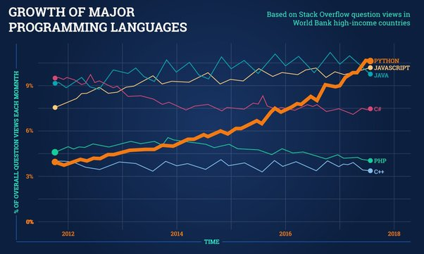

Slide 16
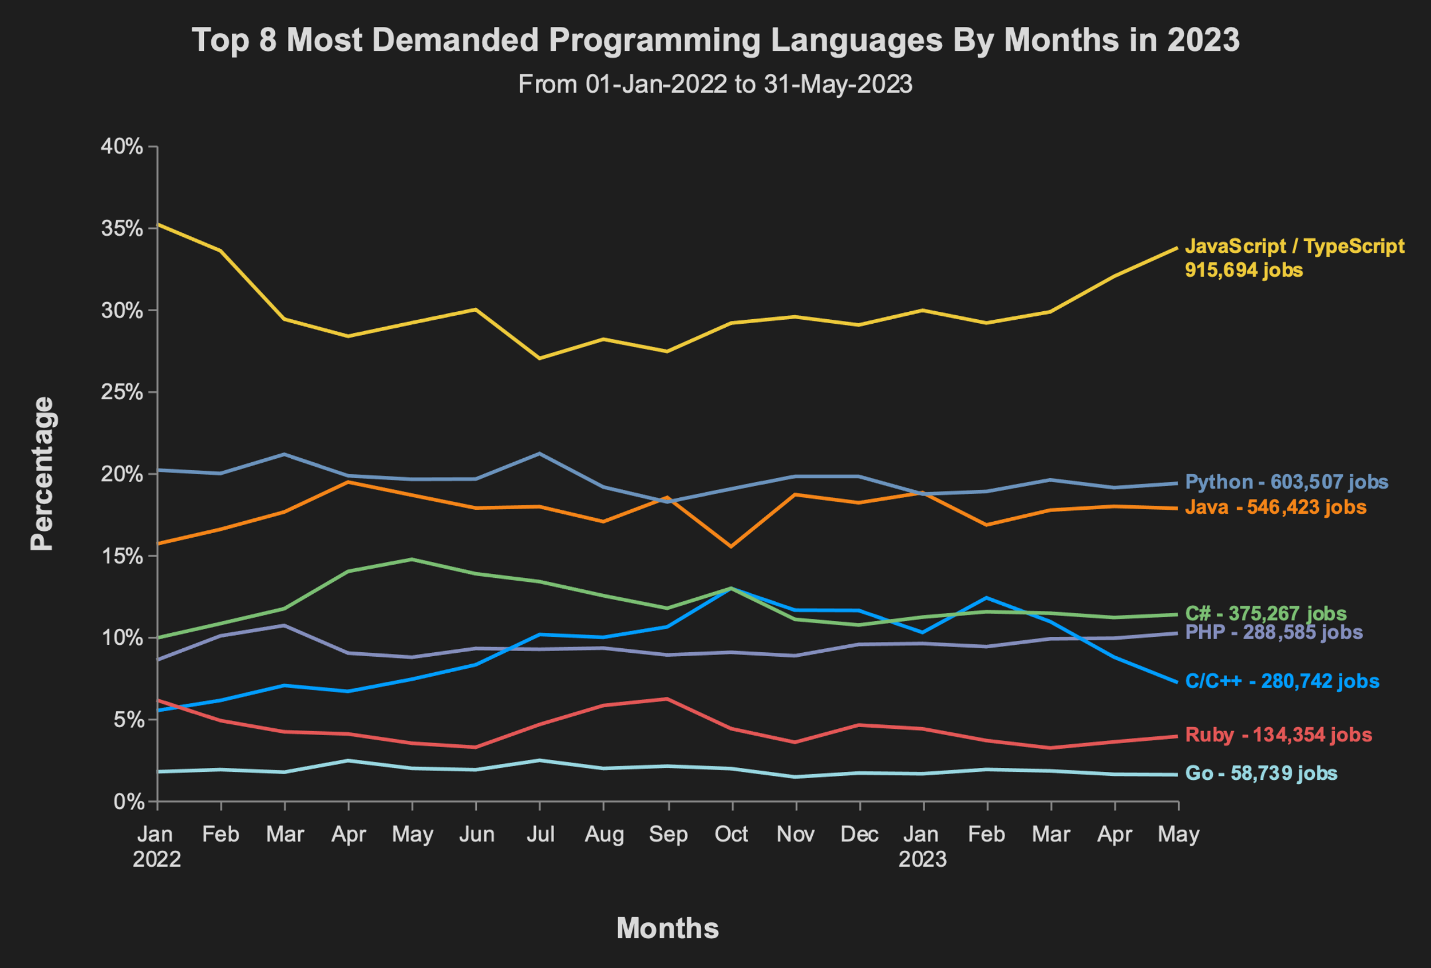

Slide 17


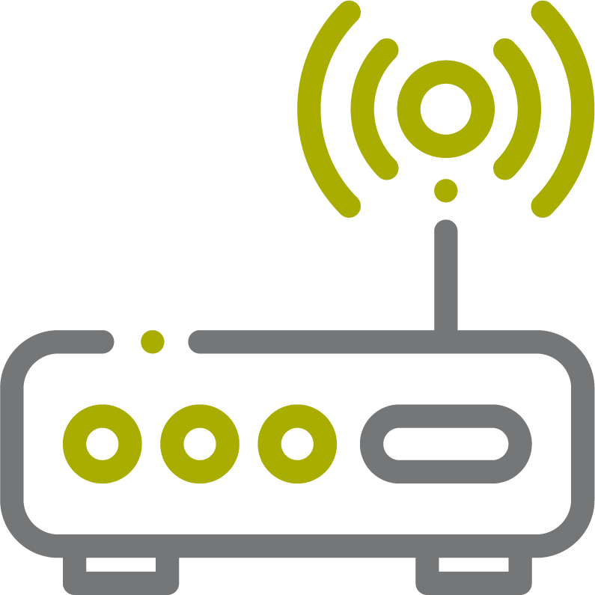

ACQUISITION
DATA
Get parameter measurements from dedicated sensors
TECHS/TOOLS
DATA
Life-Cycle
TRANSPORT
DATA
Formatted data are sent to receiver hub for processing and storage
TECHS/TOOLS

Slide 18
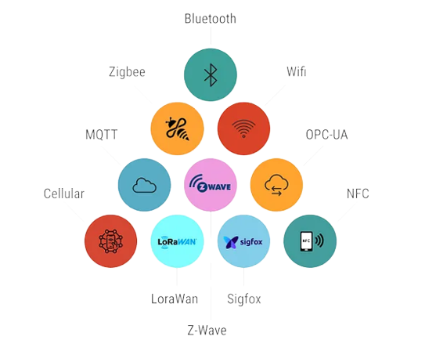
Communication Protocol
Serial Communication
Modbus
MQTT
LoRa
Sigfox
WiFi
Bluetooth
ZigBee
Factors to consider for IoT Communication
How much data do you need to transmit ?
How many device will be transmitting data at the same time ?
How will the sensors be powered up ?
What technologies and platforms will you be using ?

Slide 19
HOW To Get The Code
Search Online for the specific sensor.
Search for the correct device you are using (E.g. Raspberry Pi, Arduino, Gateway)
Visit Website below to start your own IOT Project https://create.arduino.cc/projecthub https://projects.raspberrypi.org/en
https:/github.com/hanifr
Different device will use different coding language. e.g: Raspberry Pi = Python, Arduino = C / C++

Slide 20


ACQUISITION
DATA
Get parameter measurements from dedicated sensors
TECHS/TOOLS
DATA
Life-Cycle
TRANSPORT
DATA
Formatted data are sent to receiver hub for processing and storage
ANALYSIS
TECHS/TOOLS
TECHS/TOOLS
DATA
Provide daily, weekly, and monthly data trends

Slide 21
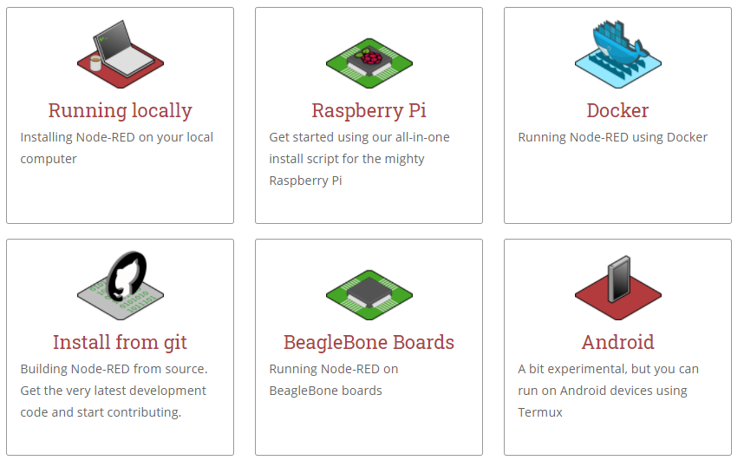
Node - Red
Browser-based editor
Able to run locally, on a device or in the cloud
Reference : https://nodered.org/docs/getting-started/

Slide 22
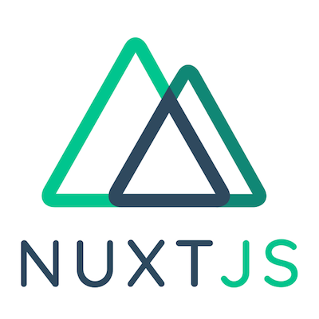



ACQUISITION
DATA
TECHS/TOOLS
Get parameter measurements from dedicated sensors
TECHS/TOOLS
DASHBOARDING
DATA
Provide graphical representations for better understanding of data trends
DATA
Life-Cycle
TRANSPORT
DATA
Formatted data are sent to receiver hub for processing and storage
TECHS/TOOLS
ANALYSIS
TECHS/TOOLS
DATA
Provide daily, weekly, and monthly data trends

Slide 23
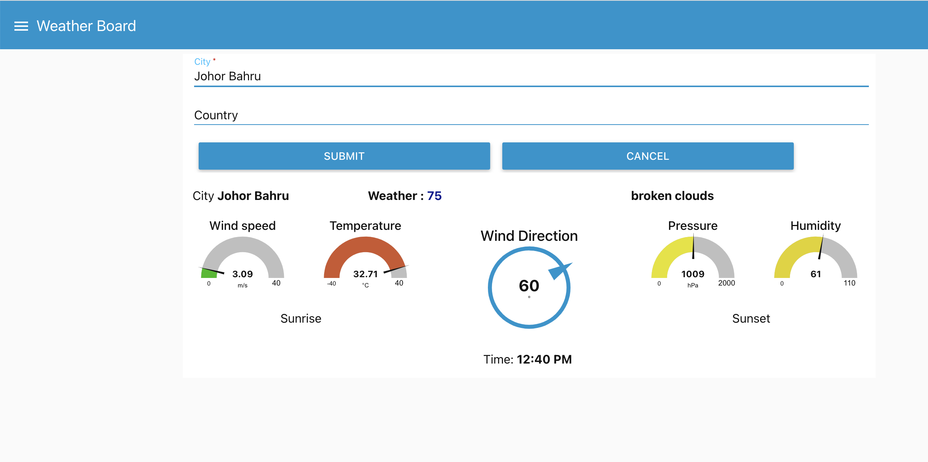
Flow Link: https://github.com/hanifr/docker-mariadb-mosquitto-rpi

Slide 24
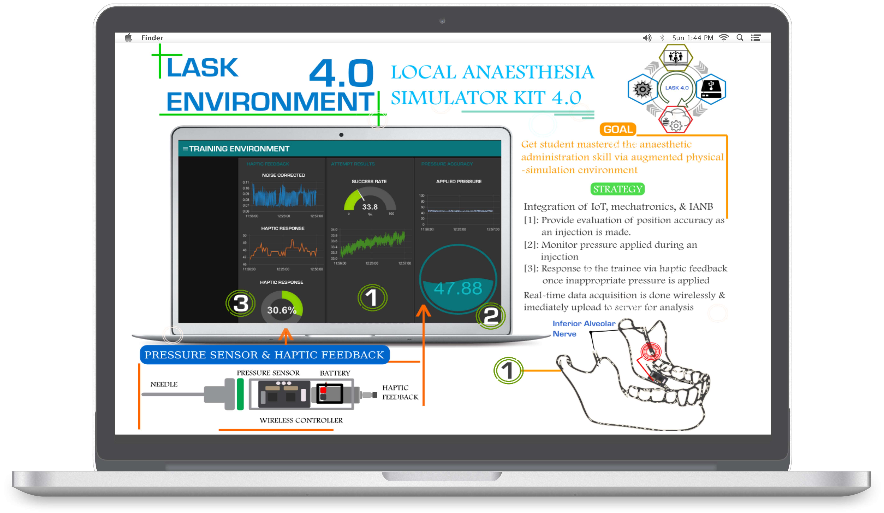

Slide 25
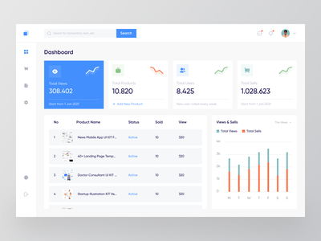




INTERNET OF THINGS
Web dashboard/ Mobile application
Notification Media
DESKTOP/MOBILE
Email, Telegram, WhatsApp
MIDDLEWARE
Data collection
Data analyze
Data interpretation
Cloud storage
IoT device / Microcontroller
IoT devices (Hardware)

Slide 26



Example of microcontroller
Arduino UNO
Arduino MEGA
TTGO LORA
ESP32
ESP8266

Slide 27
Software Installation
Node-RED

Slide 28

Node-RED Installation
Install Node.js in the following link https://nodejs.org/en
Click on the “18.16.0 LTS Recommended For Most Users”

Slide 29

Once the installation is complete, go to search bar and search for “Command Prompt” and open it.
In the command prompt window, type “node --version && npm --version”.
Make sure it return two version number.

Slide 30

Now let's begin installing Node red. In the command Prompt type “npm install -g --unsafe-perm node-red”
Please note if the module does not install and throws up error messages regarding permissions, you will need to run CMD in Administrator mode. If you are having trouble with this, please contact your System Administrator.

Slide 31




Dashboarding
02
03
01
04
80%
60%
50%
40%
01
Dissolved-Oxygen
02
Ammonia
03
pH Level
04
TMP

Slide 32


Slide 33


Slide 34





Traditional vs Tech Farming
Save time, installation requires only a smartphone for monitoring.
Accessible data when and where you need it.
Compare soil state levels by day, week, or by season to make smart decisions for increases in yield.
Probes are completely wireless and portable.
pH
Volumetric
Rain
Fertigation

Slide 35
Getting started with Node-RED

Slide 36

Node-red Installation
1. Accessing the Node-RED Apps
After the installation is completed, in the command Prompt type “node-red”

Slide 37

Please find the IP address and paste it in the google browser:

Slide 38

Paste it in the google browser:

Slide 39




Main components in Node-RED
Nodes for programming.
- Pre-built blocks of code that perform specific tasks.
- Receive data from sensors or send messages to other systems.
Tabs for configuring and organizing those nodes.
- To organize nodes and configure their settings.
- Define which nodes connected and how they process data.

Slide 40
Node-Red Basic Nodes
Node-RED offers a diverse collection of built-in nodes that serve a variety of purposes. Some of the basic nodes in Node-RED include the "Inject" node, which allows you to inject messages into the flow, the "Debug" node, which displays messages in the debug console, and the "Function" node, which enables you to create custom JavaScript functions for manipulating messages. Additionally, there are "MQTT," "Dashboard IO," and "JSON" nodes available. A summary of the functions of each node is presented in the following table.
Inject | Versatile configurable input node: inject timestamp, strings, or values
Debug | Versatile configurable output node: For debug purpose
MQTT | Data Broker node: Subscribe/publish data from/to a database, hardware, website, and other API.
Function | Function node: Use JavaScript to process incoming data (sort, filter, count, statistical analysis, etc.).
MySQL | Manage databases based on Sequence Query Language
Dash IO | Versatile configurable nodes to suit flexible data display requirements.
JSON | Converter node to suit flexible data format.

Slide 41

Managing External Node Modules
Click on the hamburger menu icon on the top-right corner of the screen.
Click on "Manage palette".

Slide 42

Managing External Node Modules
Installing Dashboard UI Nodes:
In the pallete manager install section, search for “node-red-dashboard”.
Click on install.

Slide 43

Managing External Node Modules
Installing MQTT nodes
In the pallete manager install section, search for “mqtt”
Click on install

Slide 44
Communication Protocol using MQTT
Display Sensor Data fetched by MQTT
First, you need to configure the MQTT nodes. There are two type of MQTT nodes available in Node-Red.
“MQTT in” node is used to listen or receive messages from an MQTT broker.
“MQTT out” node is used to publish messages to an MQTT broker.
Once the MQTT nodes are configured, you need test the connectivity, and finally change the subscribe topic to suit your transmitted data MQTT broker.
Note: MQTT broker is a server that helps IoT devices communicate with each other using the MQTT messaging protocol. It acts as a message hub that receives messages from publisher devices and delivers them to subscriber devices based on the topics they have subscribed to. The broker plays a critical role in enabling efficient and scalable communication between IoT devices.
To configure MQTT nodes, follow these steps:
Drag and drop the following nodes from the Node-RED palette onto the programming canvas:
Inject node: to inject test messages.
Debug node: to display messages in the debug sidebar.
MQTT in node: to receive messages from an MQTT broker.
MQTT out node: to send messages to an MQTT broker.

Slide 45

Communication Protocol using MQTT
Connect the nodes as follows:
Connect the output of the “Inject” node to the input of the “MQTT out” node. This will publish test messages to the MQTT broker.
Connect the output of the “MQTT in” node to the input of the “Debug” node. This will display received messages in the debug sidebar.

Slide 46

Communication Protocol using MQTT
Configure the "MQTT in" and “MQTT out” nodes:
Double click on the “mqtt in”.
For the topic, enter “ea/datc/data”.
Choose “Add new mqtt-broker…” and click on the pencil icon.
Enter the followng details:
Name: txio
Server: www.txio.live
Port:1883
Click on “Update”.
Insert the topic. Example: ea/datc/s/data
Click on “Done”.
Repeat the same process for “MQTT out” node.

Slide 47


Communication Protocol using MQTT
Test MQTT connectivity
Click on the "Inject" node to send a test message to the MQTT broker.
Observe the output in the debug tab to ensure that the message was successfully sent and received.

Slide 48
Dashboarding

Slide 49
DASHBOARDING
Adding Display Components
To set up a display node into a dashboard, follow these steps:
Open the Node-Red palette and drag the following nodes onto the programming canvas:
MQTT in node: This node will receive messages from an MQTT broker.
Debug node: This node will display messages in the debug sidebar.
Gauge node: This node will display temperature data.
Connect the nodes as follow
Connect the output of the “MQTT in” node to the input of the “Debug” node. This will display the received messages in the debug sidebar.
Connect the output of the “MQTT in” node to the input of the “Gauge” nodes.

Slide 50

DASHBOARDING
The flow will look like this

Slide 51

DASHBOARDING
Set the “Gauge” 1 node as follows:
Double click on the Chart.
Make changes according to the following diagram.
Once all the parameters are set, make sure to click “Update”, “Done”, and finally “Deploy”.

Slide 52



DASHBOARDING
Accessing the UI Dashboard
In Node-RED, locate the right-hand side of the screen and click on the downward arrow icon.
Select “Dashboard” from the drop-down menu.

Slide 53
THANK YOU!

